Slide 1
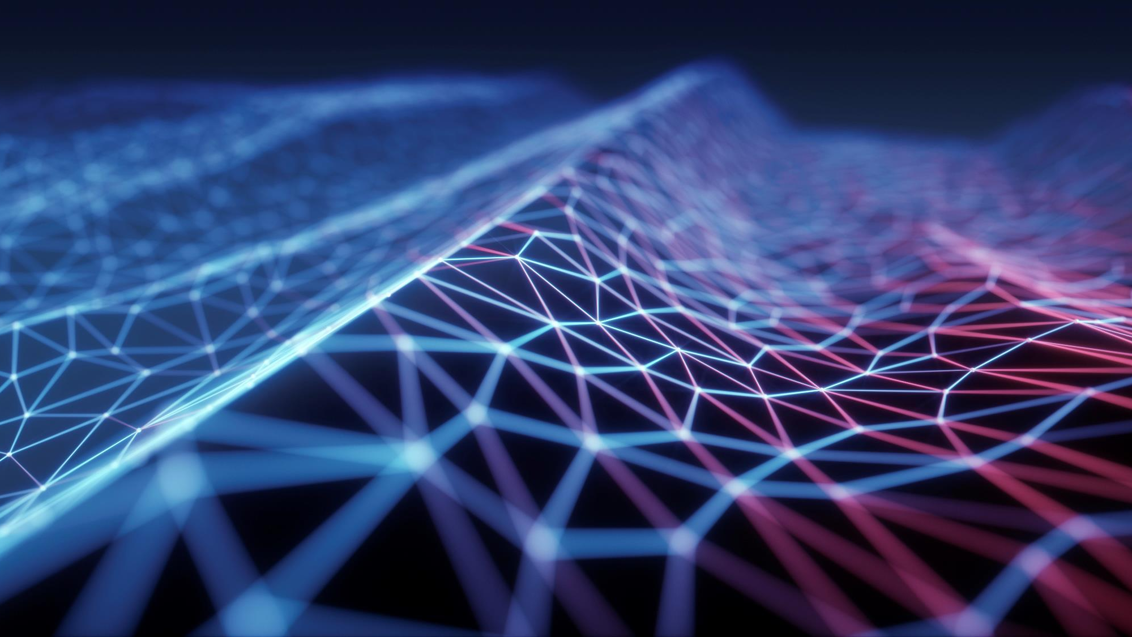
Forensics Investigation of IOT Devices:
Principles & Hands-On Experimentation
Student: Natalie Lewis
Supervisor: Prof. N. Vlajic

Slide 2
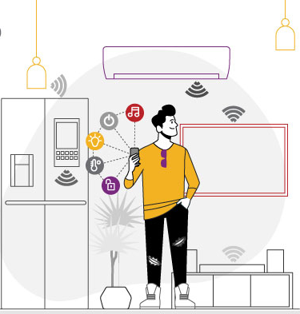
Project Objectives
Acquire in-depth knowledge of digital forensics process
Conduct research on unique challenges and opportunities pertaining to the use of IoT devices/evidence in a forensics investigation process
Obtain hands-on experience in conducting IoT forensics investigations using traditional forensics tools

Slide 3
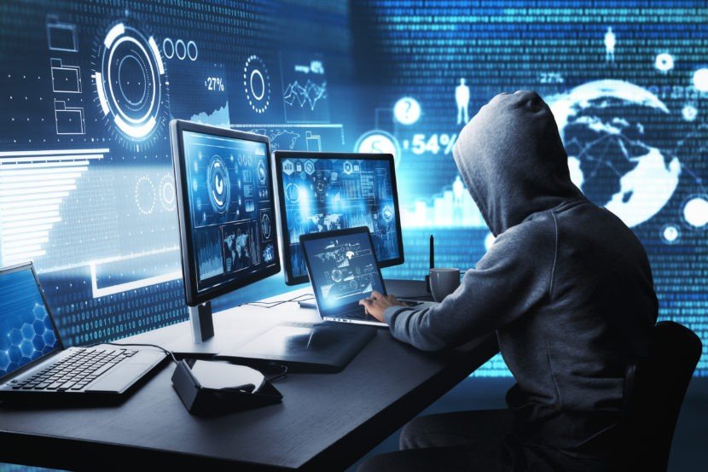
Digital Forensics: Overview
Digital forensics uses scientific methods to preserve, analyze, and present digital evidence in a cyber forensics investigation
The main goal of a digital forensics investigation is to determine means, motive, and opportunity for why and how an attack happens
Devices involved in a digital forensics investigation may include computers, mobile devices, storage media, cloud systems, networks, and IoTs
5 main stages of a digital forensics investigation:
    Identification
    Preservation
    Acquisition
    Examination
    Reporting

Slide 4
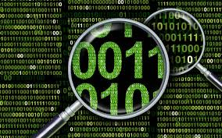
Stage 1: Identification of Digital Evidence
Identification determines what evidence exists and where
Uses the 5WH model:
    Who
    What
    Where
    When
    Why
    How
Evaluate all devices, storage media, cloud accounts, AND all data that can be accessed on confiscated devices
First responders must secure the scene, avoid making assumptions based on how the scene is discovered, and document all observations

Slide 5
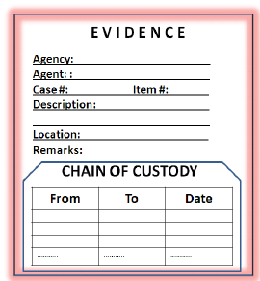
Stage 2: Preservation & Evidence integrity
Evidence must be preserved exactly as it is found to maintain evidence integrity
Chain-of-custody document records every transfer of the evidence and traces back the chain if evidence becomes compromised
Techniques for data/evidence protection:
    Write-blocking - Prevents original evidence from being modified
    Read-only copies
    Hashing for integrity verification
    Backup for redundancy
Consequences of improper data/evidence handling:
    Modified timestamps
    Disabling of fail-safe controls against encryption or malware
    Volatile data destroyed

Slide 6
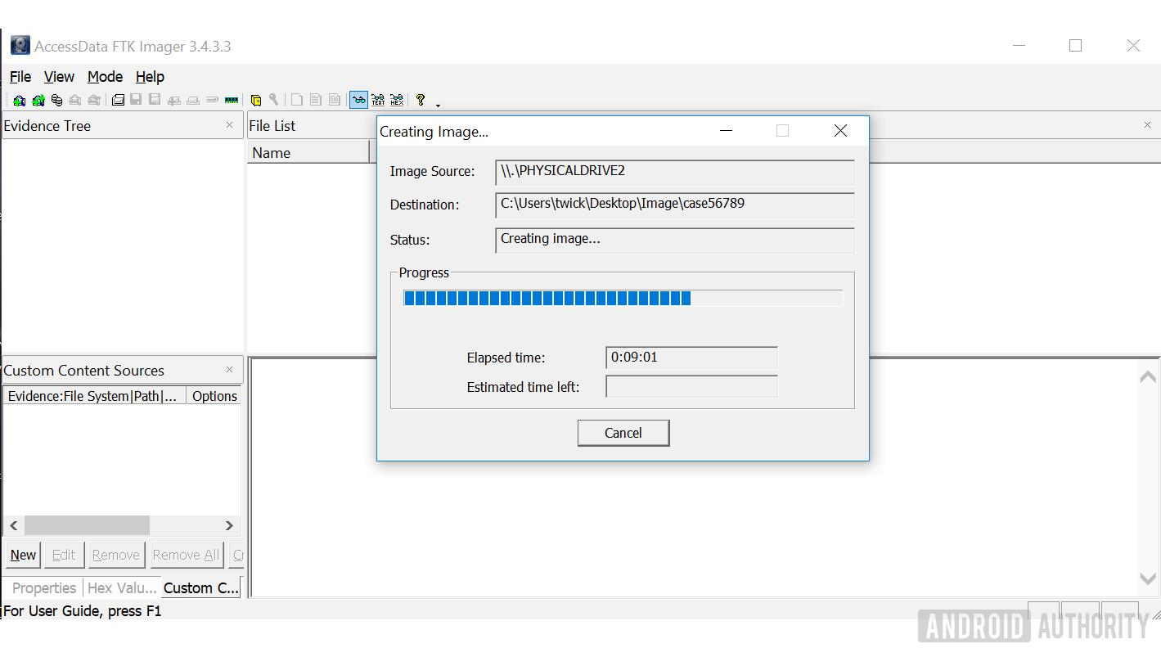
Stage 3: Acquisition of digital evidence
Evidence/data should be extracted for forensic analysis and stored on secure external drive
Copy is made using bit-for-bit forensic imaging
which results in an exact sector-by-sector copy of
the original storage medium
Important acquisition principles:
  Never working with original evidence (!)
  Create forensics images using sterile media
  Protect created images with hash values
Tools for forensic imaging
  FTK Imager: Previews, acquires, and verifies images
  PALADIN: A bootable Linux-based forensic environment

Slide 7
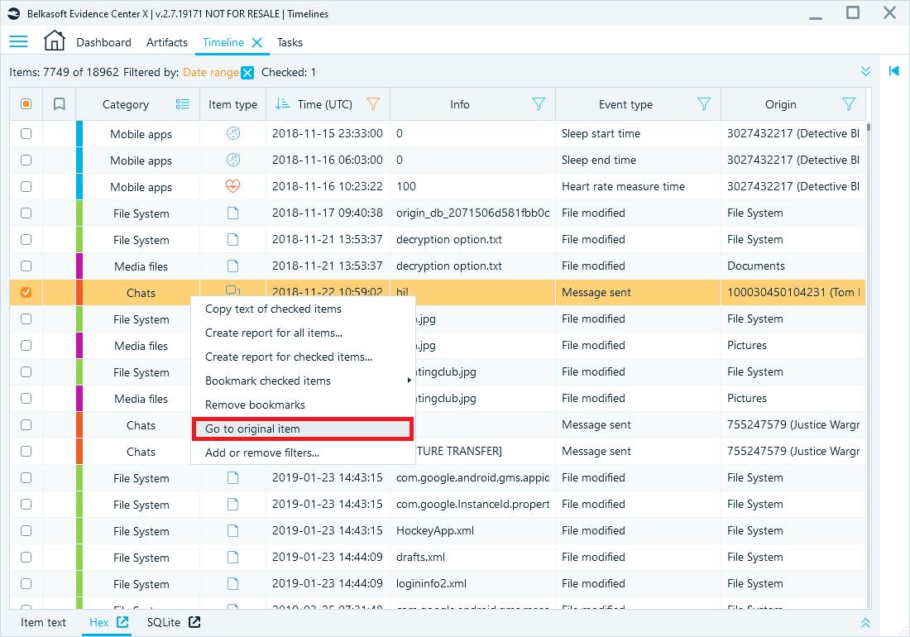
Stage 4: examination & Analysis
Determines what happened using:
    Timeline analysis & timestamp normalization
    Activity & relationship analysis
    File signature validation
Can detect tampering through:
    Altered timestamps
    Missing user data or applications
    Inconsistent databases
    Selective deletion of information
Anti-forensics techniques can make forensics analysis more complex, slower, or outright impossible

Slide 8
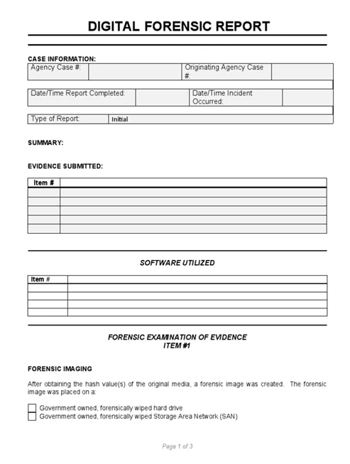
Stage 5: Reporting & Presentation
Forensics report should include:
    Case details & scope of the investigation
    Tools & methods used to draw conclusions
    Findings & limitations of what was found
Writing style should be built on:
    Clarity
    Conciseness
    Correctness
Report should effectively communicate findings to both technical & non-technical audiences (e.g., courts, management, decision-makers)
Report should ensure evidence is understandable & admissible
in a legal trial, if required

Slide 9

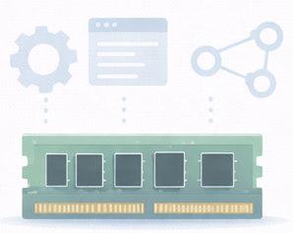
DISK & MEMORY FORENSICS
Disk & Memory Forensics are both essential to digital forensics process
and generally complement each other
Disk Forensics
      Examines non-volatile storage (Hard Drives, SSDs, USBs) that retains information after a shutdown
      Focuses on recovery of deleted files, file metadata, long-term user activity, installed applications, logs, …
Memory Forensics
      Examines volatile memory (RAM) data on live systems that may disappear after a shutdown
      Focuses on analysis of running processes, active network connections, encryption keys, injected code and fileless malware, …

Slide 10
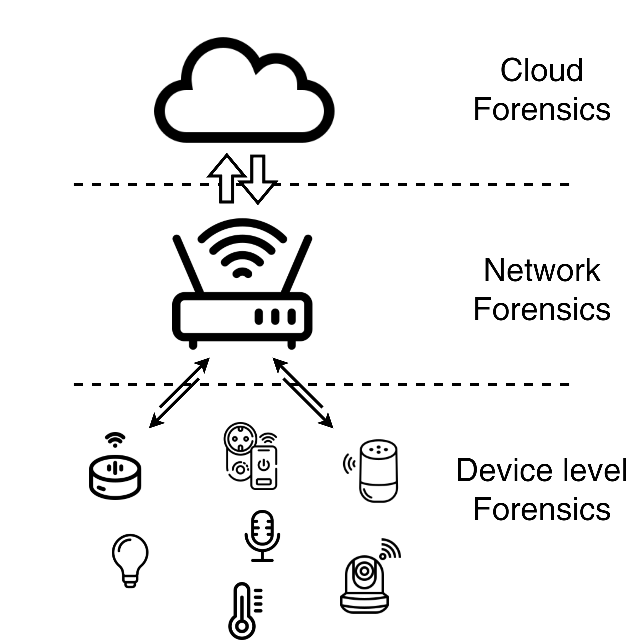
IoT Forensics: Challenges
Internet of Things (IoT) devices can range from smart homes to industrial systems
IoT evidence is often distributed across devices, networks, and cloud services
Due to limited storage, IoT devices often overwrite logs & data, or store minimal amount of information locally
IoT environments utilize proprietary data formats & file systems, and close-sourced software
As a result, traditional digital forensics methods & tools cannot effectively be used in IoT
IoT forensics is still in its infancy …
Notes:
IoT device: Non-standard computing hardware (sensors, appliances, and other machines) embedded with software, processors, and network connectivity to collect, exchange, and act on data without human intervention

Slide 11
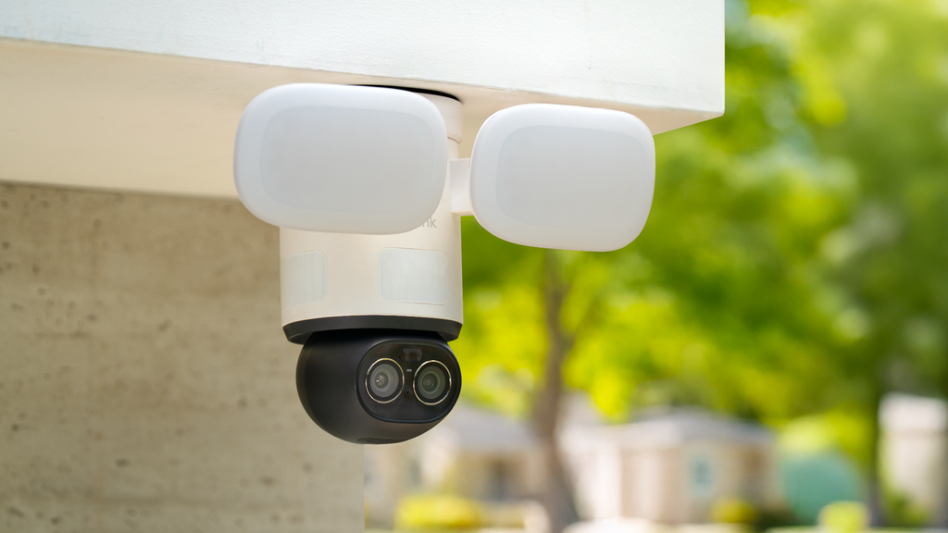
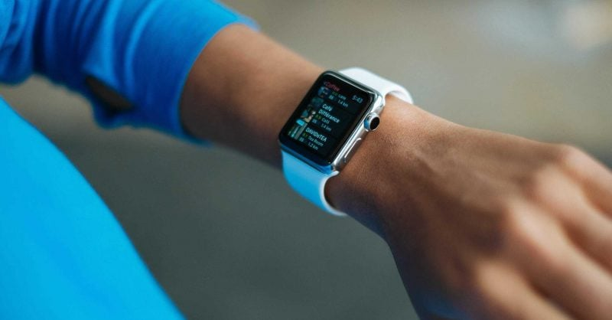
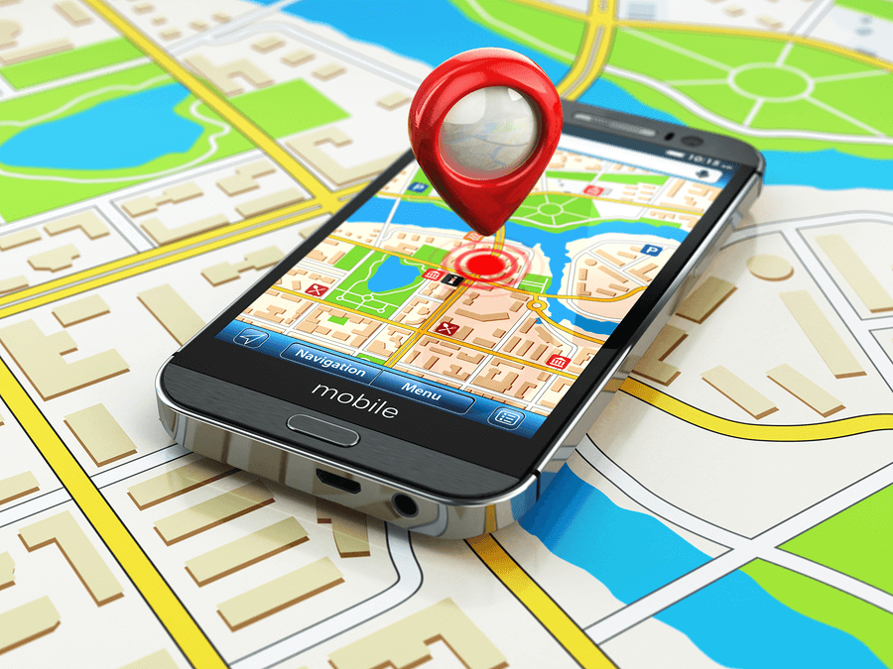
IoT Forensics: New opportunities
IoT devices provide new types of contextual evidence that does not exist in traditional systems – e.g., IoT devices collect:
  Environmental conditions
  Movement and activity
  Geo-location information
  Timestamps
Collected data is often stored in the Cloud => Evidence much harder to destroy
Cross-correlation of data collected on multiple IoT devices can provide more comprehensive & accurate timeline of events
  Can assist in uncovering sophisticated multi-stage attacks

Slide 12
IoT Forensics: Proposed methodology [1]
Preparation: Identify all devices interacting with the environment, map communication paths between devices / network / cloud services, and prioritize likely evidence sources
Acquisition: Collect data from device storage, network traffic captures, and cloud logs, use live acquisition when physical isn’t an option, and create copies while maintaining integrity
Analysis: Extract system logs, application data, user interactions, and communication traces, correlate artifacts to reconstruct attacker actions (account for unsynchronized clocks)
Evaluation: Build a unified event timeline, validate relationships between evidence sources, and confirm consistency across devices and network logs
Post-process: Report findings for legal presentation, return evidence to operational state, and update forensic procedures
[1] J. M. C. Gomez et al., ”A context-centered methodology for IoT forensics investigations”, International Journal of Information Security, 2021. https://ruidera.uclm.es/server/api/core/bitstreams/139c4ba2-88c9-42fe-8304-915354b81c63/content

Slide 13
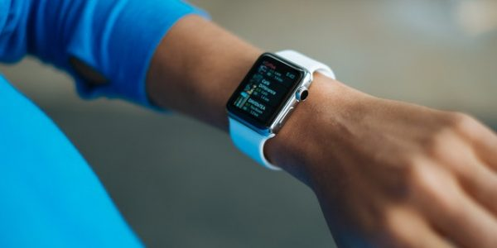
Example analysis with fitbit smartwatch [1]
Smartwatches and other wearable devices are becoming high-value forensic artifacts!
Forensic data that can be obtained from a Fitbit smartwatch include:
      Continuous heart-rate measurements
      Step counts and movement intensity
      Sleep cycles and inactivity periods
      GPS location and travel patterns
      Calorie expenditure and exercise sessions
Extraction involves retrieving data from the smartphone application associated with the watch and examining records by minute-level intervals to build timelines
During an investigation, we can determine:
      Whether a victim was alive, unconscious, or dead
      Estimate the time of death or injury
      Verify alibis through movement tracking & timestamps
      Detect unusual activity spikes or sudden inactivity
[1] A. P. Jose, “Smartwatches in Crime Investigation and Digital Forensics: Exploring Possibilities and Applications”, 11th International Conference on Smart Computing and Communications (ICSCC), 2025

Slide 14
IoT forensics challenge [1]
This challenge highlights both the power and complexity of IoT Forensics!
Findings
  Timeline reconstruction built from 6 data sources
  Irrelevant personal data was exposed, which raised privacy concerns
Lessons learned
  Existing digital forensics tools are insufficient
  Cross-device correlation is essential
  Investigations require multidisciplinary expertise
Given scenario: A woman was murdered and her husband is the primary suspect
Goal: Use artifacts to forensically determine who killed her
Challenges presented
  Evidence distributed across devices and cloud storage → large volume of data
  Need credentials to access remote data
  Multiple ecosystems that require specialist knowledge
[1] S. Mrdovic, “IoT Forensics”, Chapter 13 in “Security of Ubiquitous Computing Systems”, 2021. https://people.etf.unsa.ba/~smrdovic/publications/Mrdovic2021_Chapter_IoTForensics.pdf

Slide 15
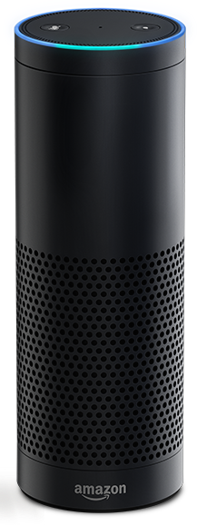
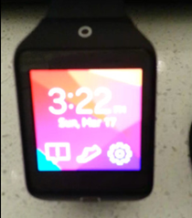
Hands-on experimentation: Overview
Conducted a digital forensic investigation through NDG labs of two IoT devices
  Amazon Echo Dot (2014 version)
  Samsung Smartwatch didn’t reveal the exact model, but it was activated in 2014
Obtained the disk images and performed acquisition and analysis of the forensic stages on the device data
Goal: Extract and analyze stored data to identify user accounts, communications and device usage patterns

Slide 16
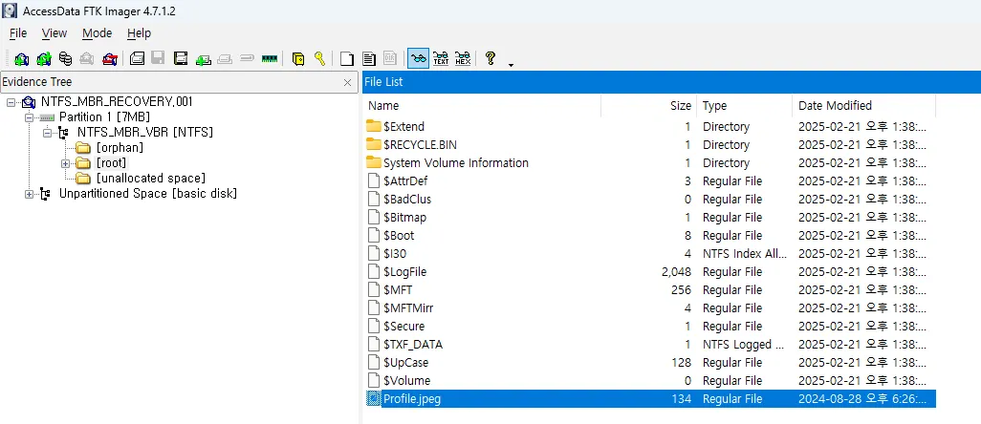
Hands-on experimentation: utilized Tools
FTK Imager
  Explore disk images and recover forensic artifacts
  Preserves evidence without modifying the original data
  Allows investigators to browse file systems and extract files
DB Browser for SQLite
  Analyze device databases
  Allows investigators to view tables, run SQL queries, and export forensic data
From the smartwatch, the Ext4 file system was observed
  It’s common in Android and Linux systems
  It stores application data, system configuration files, and user artifacts
Additional evidence is found in system logs, databases, and configuration files

Slide 17
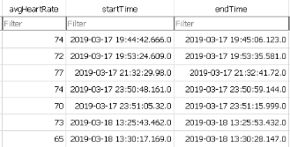
Hands-on experimentation: smartwatch results
Contained several artifacts that revealed the user’s behaviour, including activity history
Media folder stores synchronized photos, videos, and other media files
.thumb folder: A hidden folder that contains thumbnails of the items in the media folder and deleted files
A user profile was found in the health database, and it was created on March 17, 2019 at 7:07pm
Heart rate logs were also recovered, but only recorded between March 17 7:44pm-11:51pm and March 18 1:25pm-1:30pm

Slide 18


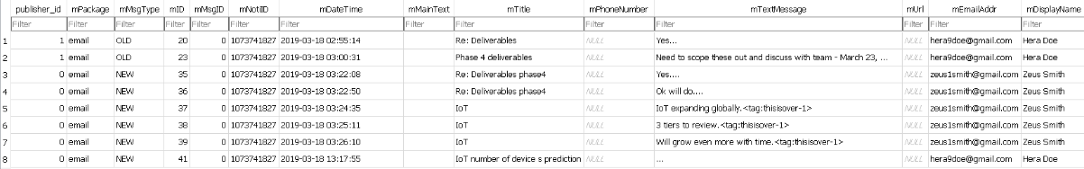
Hands-on experimentation: smartwatch results
Movement data
  Very little movement detected
  Step records taken on March 17 with 135 steps and March 18 with 222 steps
Communication data
  Email registered to the device is hera13@mail.com
  Communications occurred between zeus1smith@gmail.com and hera9doe@gmail.com
  Phone logs show the most calls occurred between Hera Doe and Zeus Smith to 214-892-8643
Notes:
Tools to handle cross-correlation between devices and proprietary formats

Slide 19
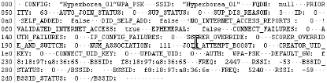
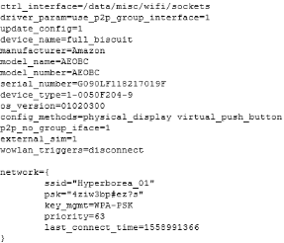
Hands-on experimentation: Echo dot results
Contained important information regarding account details and network configuration
WPA Supplicant revealed the connected WiFi network, the passphrase, and authentication protocol
Network history showed the router’s BSSID, gateway MAC address, 2.4Ghz and 5GHz access point identifiers, and internet validation status
Can help investigators link the device to a specific network and identify the device’s location

Slide 20

Hands-on experimentation: key observations
Smartwatch behaviour
  Physical movement was limited, which shows inactivity when the smartwatch was on
  Health logs were inconsistent, which shows the user didn’t wear the smartwatch consistently or potential evidence tampering
  Last activity was the Contacts application, which indicates Hera may have contacted someone before the device was examined
  Only communication between Zeus Smith and Hera Doe so Zeus Smith may have relevant information on Hera Doe
Echo Dot behaviour
  Device was connected to a WiFi network, which can reveal the device’s location
  Voice command configuration files were present, which shows how the device was being used
  User account was linked to Rachel Costello, most likely the primary user
  Now we can investigate on Rachel Costello to discover other information to further the investigation

Slide 21
Project conclusions
Digital forensics follows a structured, multi-stage process
IoT devices introduce unique challenges (data distribution, limited storage, proprietary systems, cloud storage)
Traditional forensic tools are not fully sufficient for IoT environments
Valuable evidence can be recovered from logs, databases, and network artifacts
IoT forensics is a growing and evolving field
Future investigations will require new tools, methods, and multidisciplinary expertise
This project highlights that IoT forensics expands the possibilities of digital evidence and increases the complexity of forensics investigations.

